Slide 1
Welcome
to our
Presentation

Slide 2
Presented By
Md Mehedi Hasan
ID : 221-15-5976
Rubaiyat Ferdousi
ID : 221-15-4843

Slide 3

Project : Home Rent Website

Slide 4
1
2
Introduction
Diagram
We made a simple house renting website. this topic provide a brief understanding of our project.
This topic shows a use case diagram of our project.
Content
Design
Conclusion
This topic provides screenshots of front end design in our project
3
4
This topic describe Scope for Further Developments

Slide 5

01
Introduction
INFODATA 02
INFODATA 04
Housing plays a huge role in revitalizing economic growth in any country, with shelter being among the key indicators of development. Most families choose to rent houses based on their income and family situations. Unfortunately, there may not be enough good quality rental housing for these families. The demand for rental houses is extremely high and more rental houses need to be put in place. Developing rental houses has numerous advantages, particularly for landlords, who can increase their profits through the rent paid by tenants. The increased number of tenants and landlords complicates management, especially for landlords who lose large sums of money to tenants who do not pay their rent. The above statement gives a clear declaration as to why rental house management system needs to develop.
INFODATA 01
INFODATA 03
INFODATA 05

Slide 6
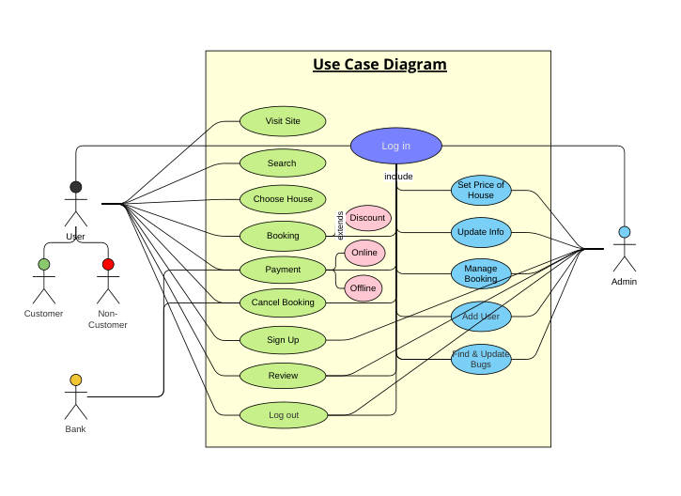
02
Diagram
INFODATA 02
INFODATA 04
INFODATA 01
INFODATA 03
INFODATA 05

Slide 7
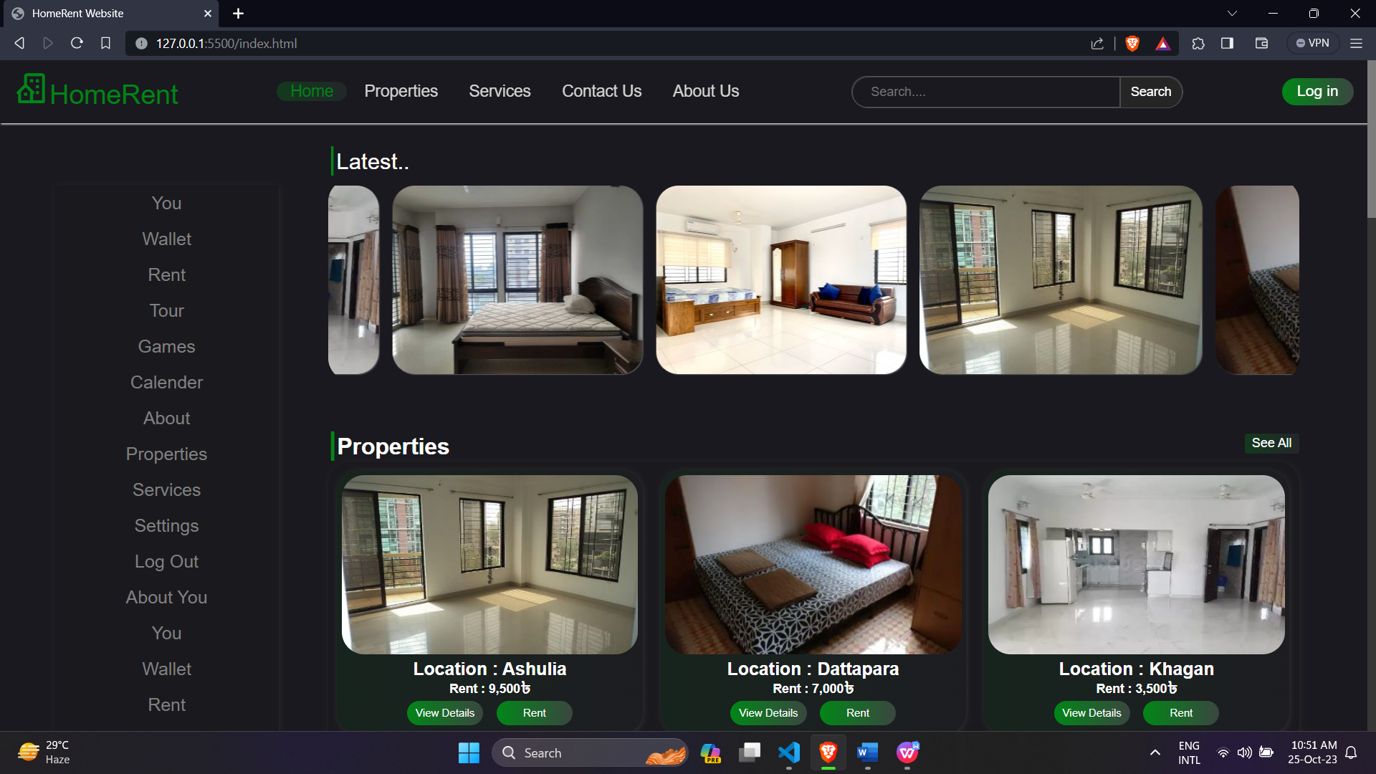
03
Design
INFODATA 02
INFODATA 04
INFODATA 01
INFODATA 03
INFODATA 05
Home Page

Slide 8
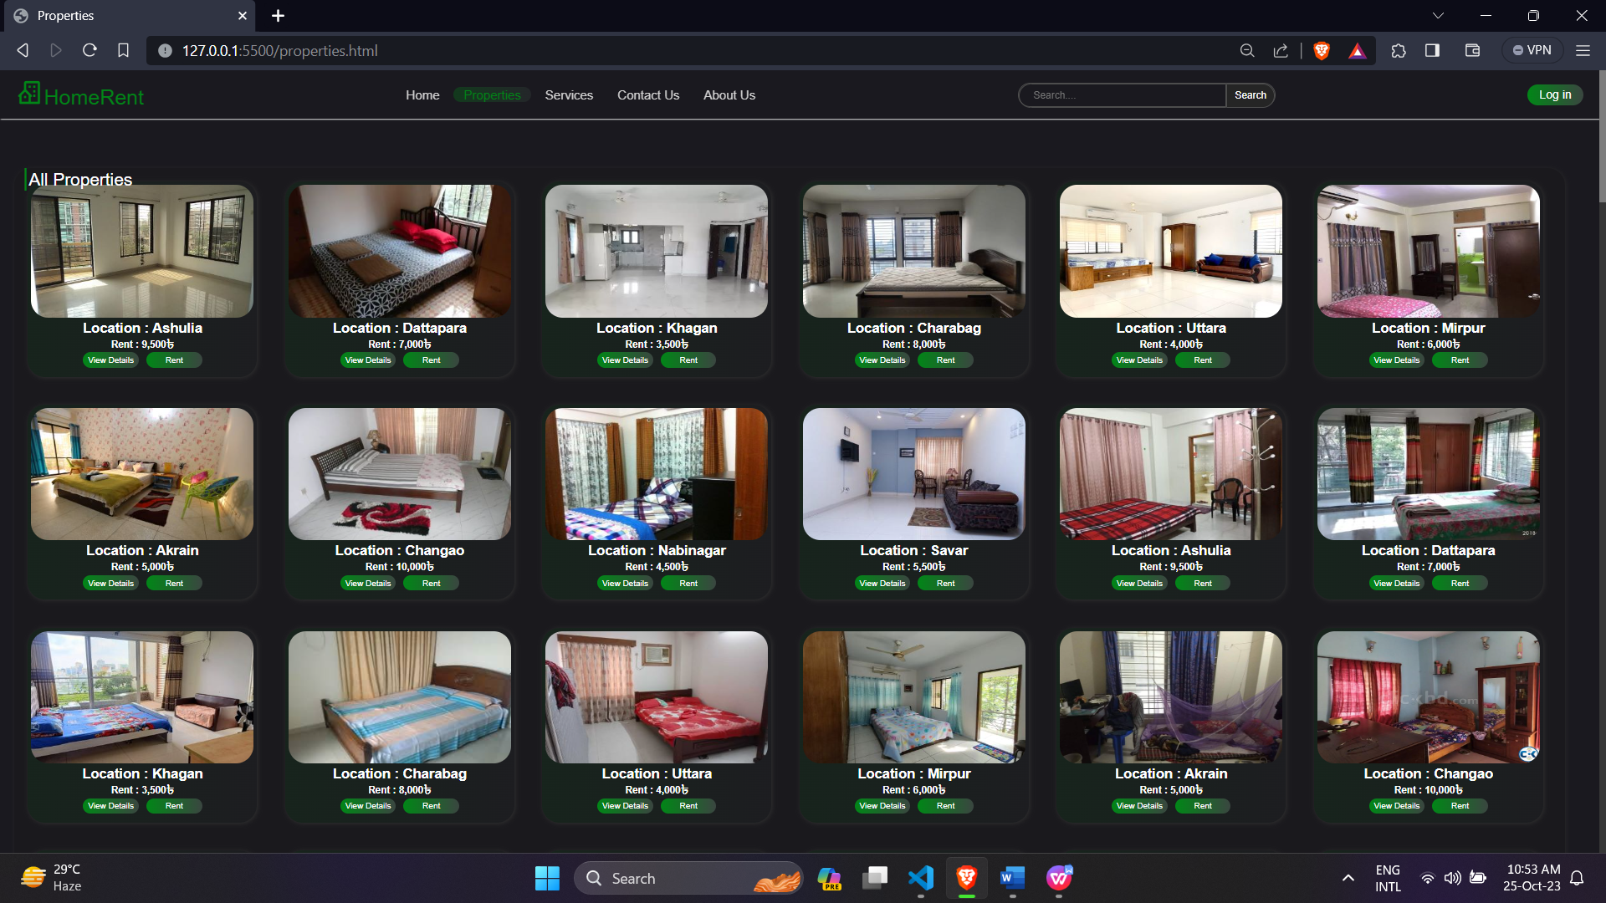
INFODATA 02
INFODATA 04
INFODATA 01
INFODATA 03
INFODATA 05
Properties

Slide 9
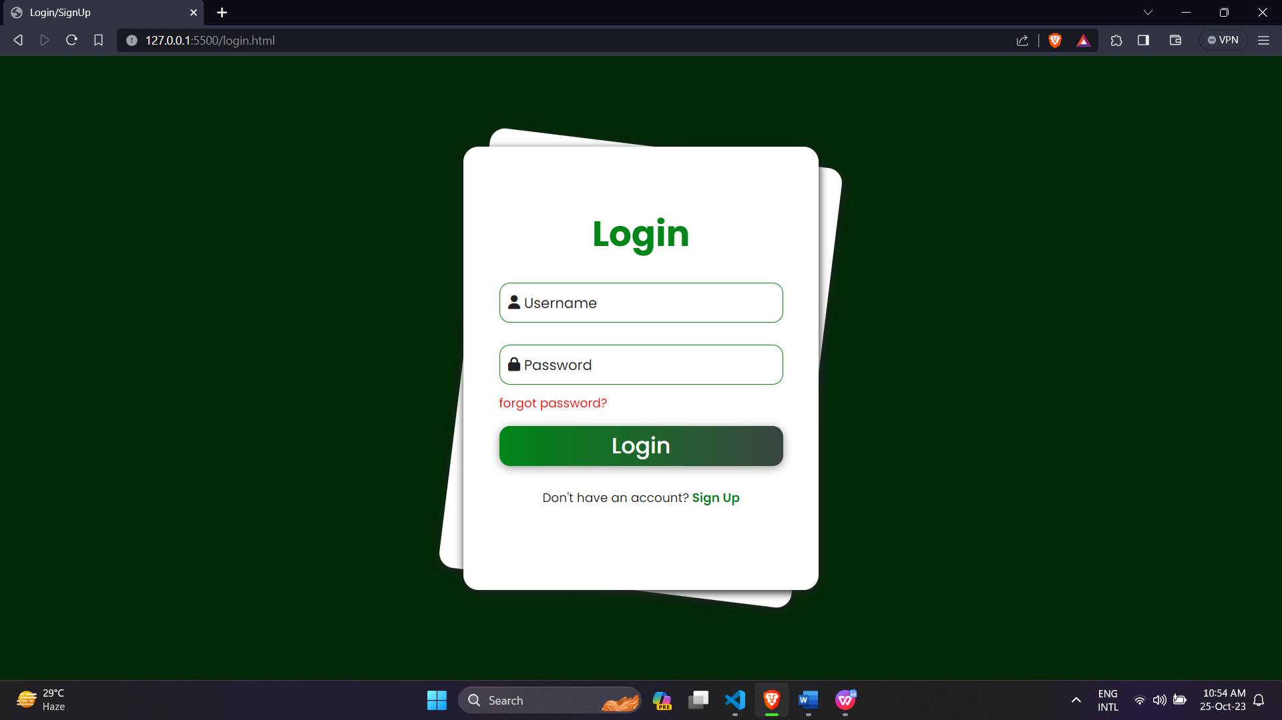
INFODATA 02
INFODATA 04
INFODATA 01
INFODATA 03
INFODATA 05
Log in Page

Slide 10
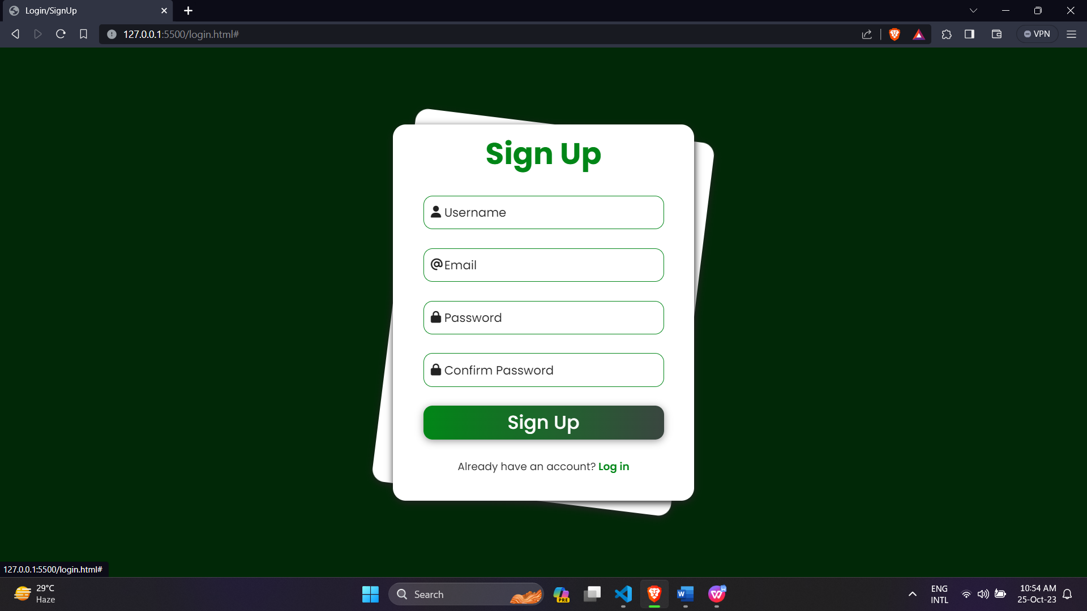
INFODATA 02
INFODATA 04
INFODATA 01
INFODATA 03
INFODATA 05
Sign Up Page

Slide 11
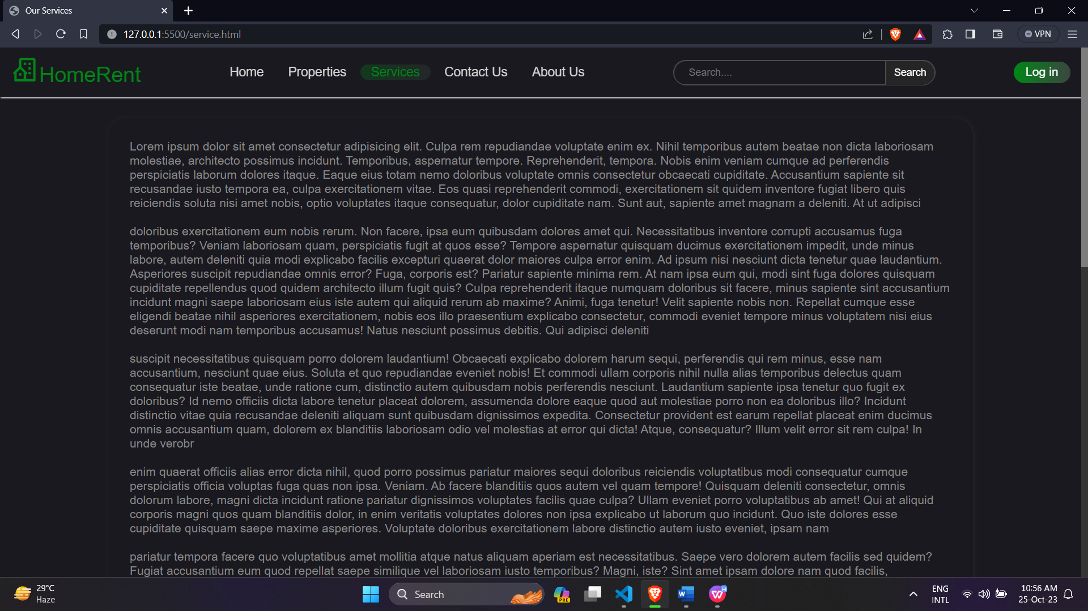
INFODATA 02
INFODATA 04
INFODATA 01
INFODATA 03
INFODATA 05
Services Page

Slide 12
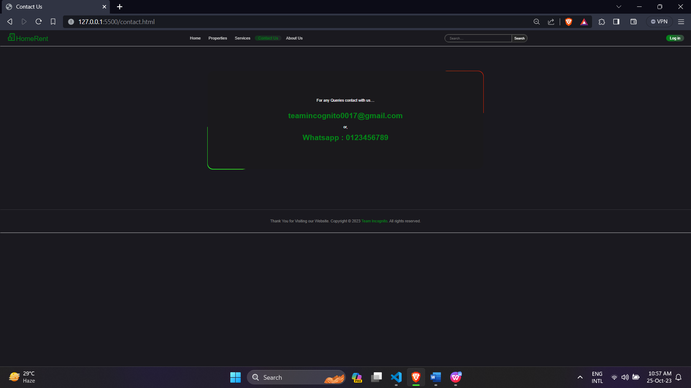
INFODATA 02
INFODATA 04
INFODATA 01
INFODATA 03
INFODATA 05
Contact Page

Slide 13
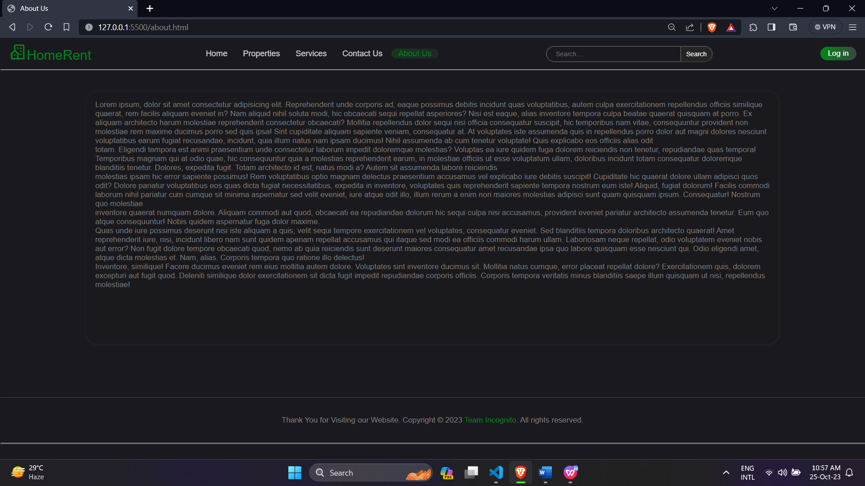
INFODATA 02
INFODATA 04
INFODATA 01
INFODATA 03
INFODATA 05
About us Page

Slide 14
Conclusion &
Future Scope

Slide 15
Design
The project is finished with the help of html, CSS and JavaScript. People can use it from anywhere by using a Smartphone with the help of an internet connection
Future Scope
It is already a user-friendly application, but in the future, we are thinking about adding some more
features to make this application more user friendly
Virtual Tour
In future we are trying to add a feature that provides user a 3d tour of their desire home
IOS Version
This project can also be extended to IOS Platform and we want to extend the project not only in our country but also worldwide.

Slide 16
Thank You

